Slide 1
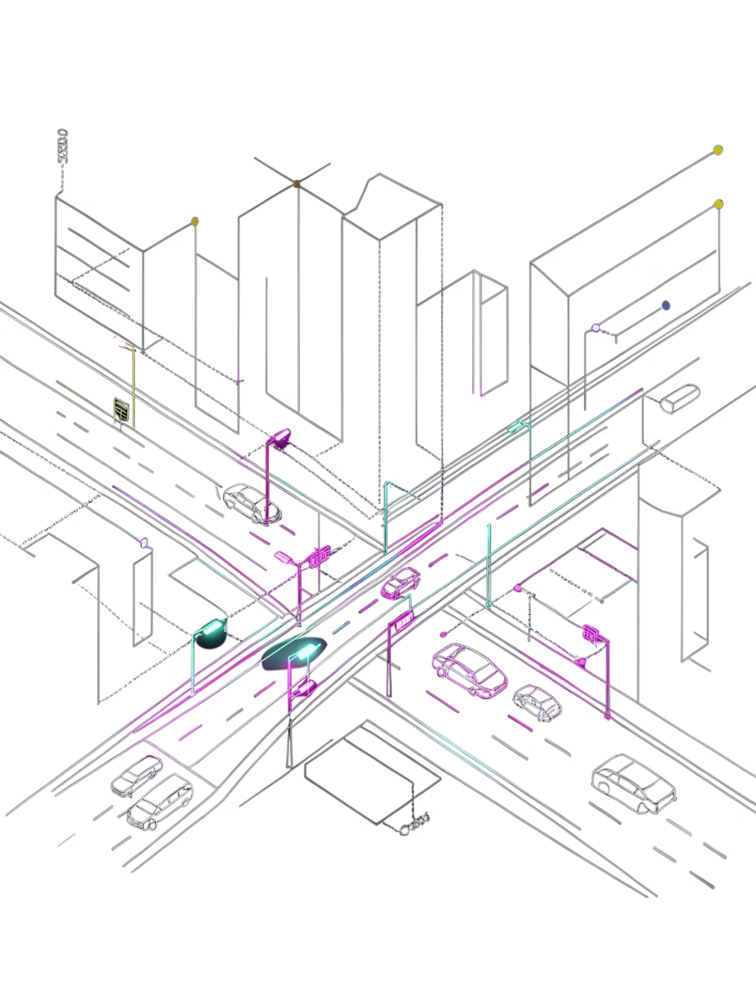
Design & Simulation of an Automatic Street Light Control System
Energy-Efficient Smart City Infrastructure using Combinational Digital Logic
Digital Design & Computer Architecture Lab

Slide 2
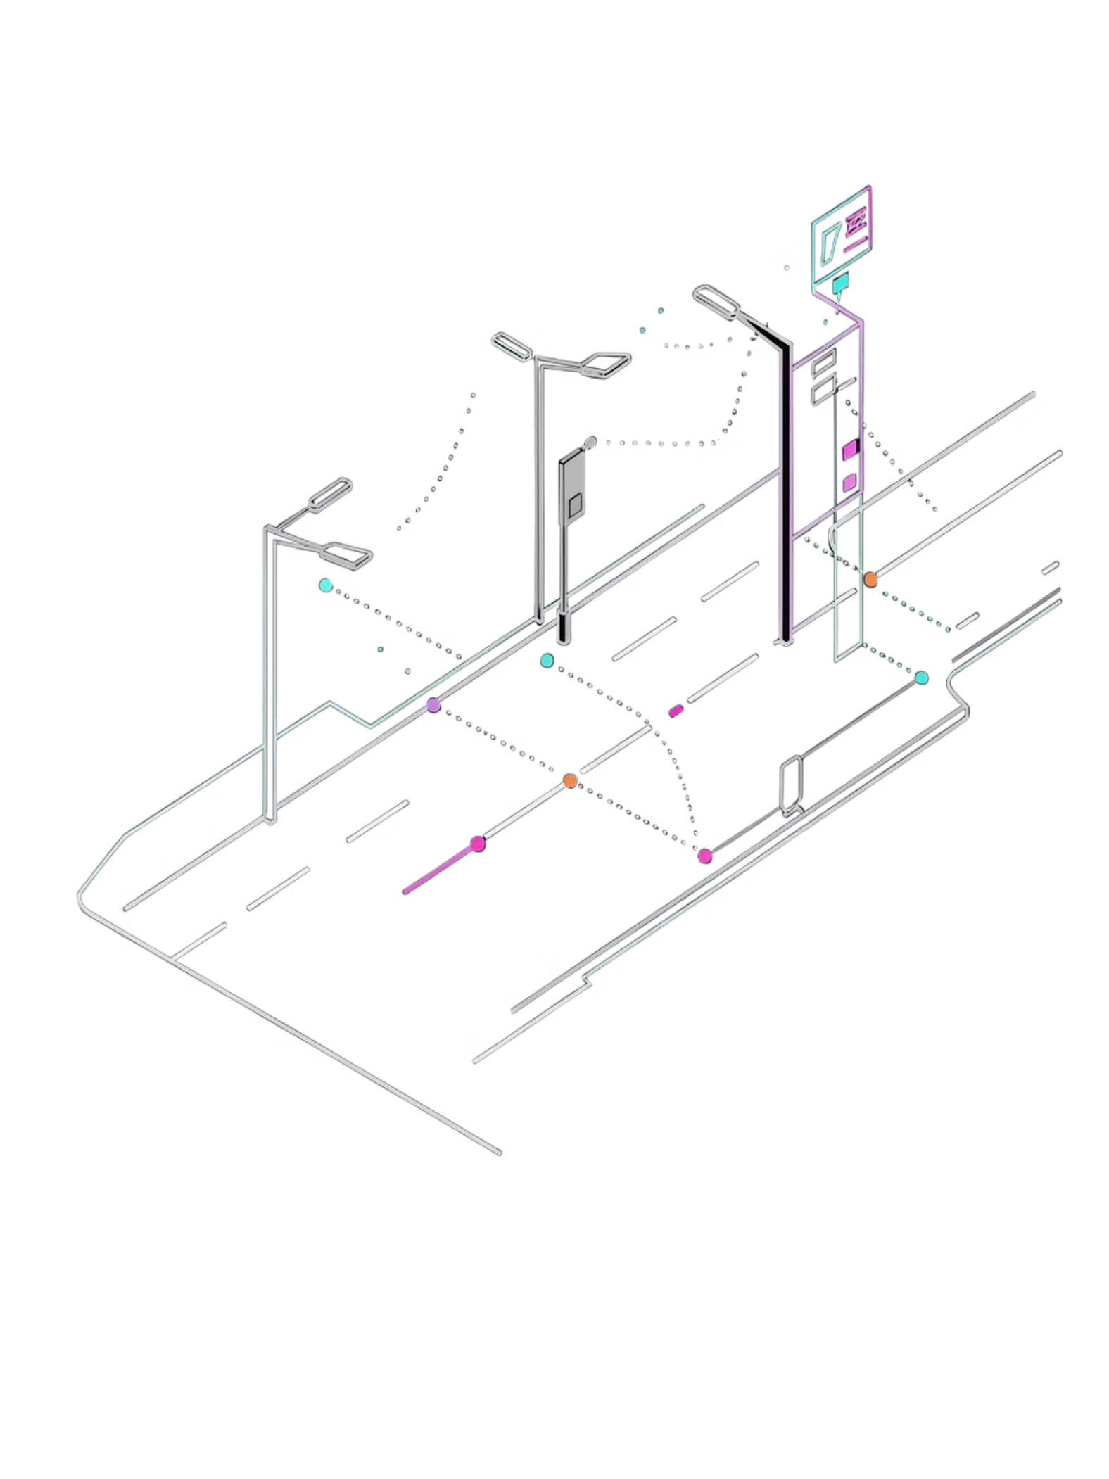
Problem Statement & Project Goal
The Problem
The Solution
Traditional street lights run at 100% brightness all night, causing massive electrical energy waste and inflated municipal costs.
A smart, sensor-driven control system using combinational digital logic gates that toggles between Off (Day), Dim/30% Standby (Night Idle), and Full/100% Brightness (Night Motion / Maintenance Override).

Slide 3
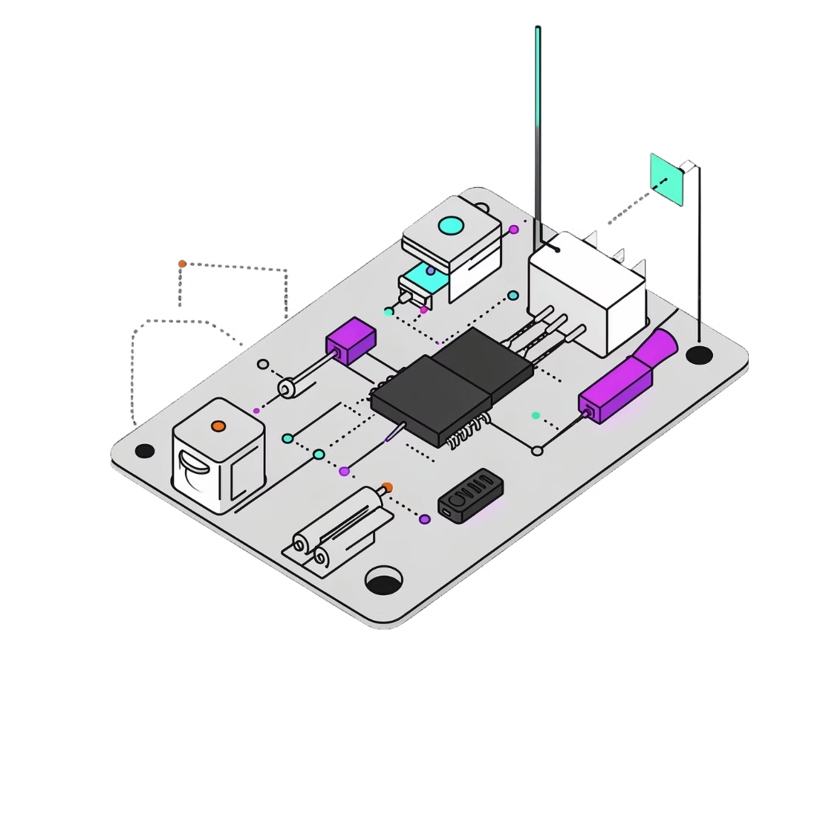
System Architecture & Sensor Inputs
DIGITAL INPUTS
L — LDR Sensor
M — PIR Motion
O — Override
O=1 Maintenance | O=0 Auto Mode
L=1 Daylight | L=0 Darkness
M=1 Motion | M=0 Empty Road
CONTROL OUTPUTS
S1 — Full Light
S0 — Dim Light
100% Power High-Brightness LED
30% Power Energy-Saver LED

Slide 4
Truth Table & System States
condition | L | M | O | S1 | S0 | State
Daytime | 1 | 0 | 0 | 0 | 0 | Off
Daytime Traffic | 1 | 1 | 0 | 0 | 0 | Off
Night Idle | 0 | 0 | 0 | 0 | 1 | 30% Dim Standby
Night Active | 0 | 1 | 0 | 1 | 0 | 100% Full Brightness
Maintenance Mode | X | X | 1 | 1 | 0 | Forced Full Power

Slide 5
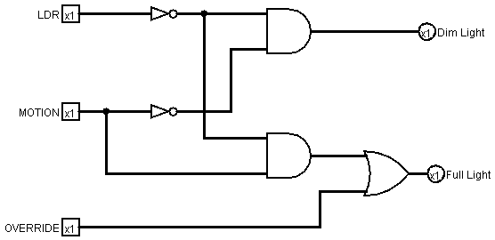
Logism circuit

Slide 6
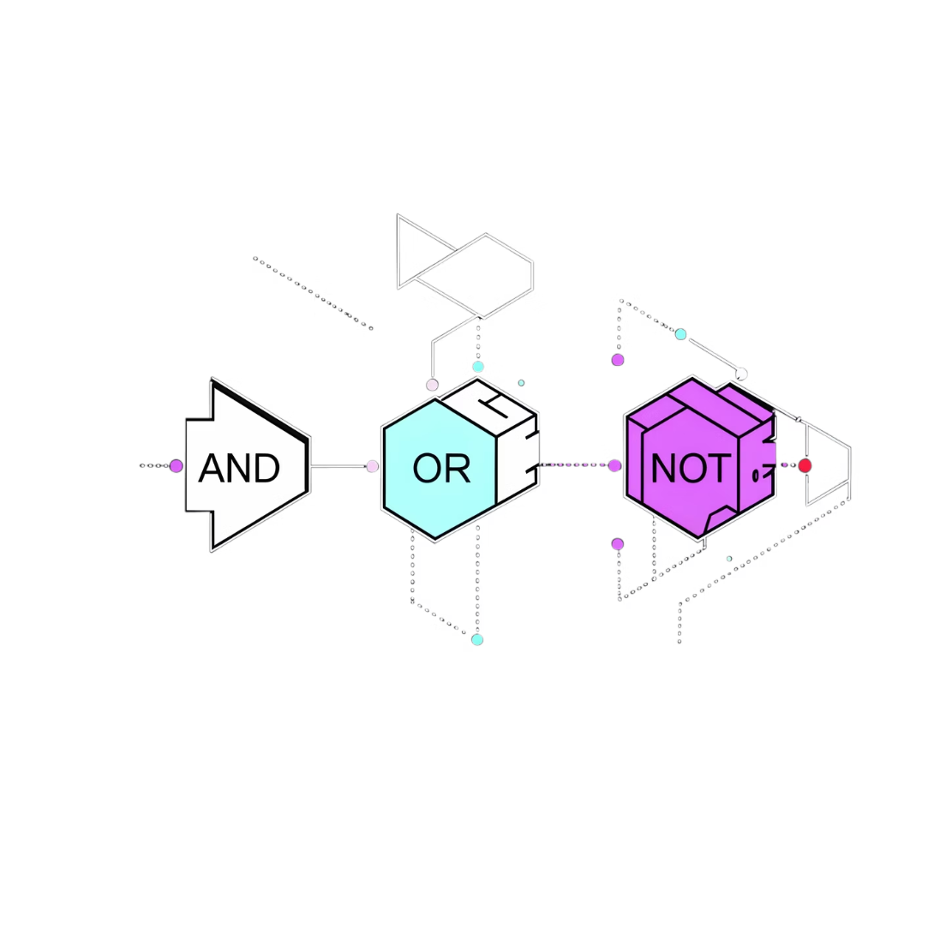
Boolean Logic Derivation & Equations
SIGNAL NOTATION
OUTPUT EQUATIONS
S0 (Dim Light) = L̄ AND M̄ AND Ō
S1 (Full Light) = (L̄ AND M) OR O
Using AND, OR, and NOT gates keeps chip count minimal for fast response time and low circuit cost.
Night
No Motion
No Override
NOT(L) = L̄
NOT(M) = M̄
NOT(O) = Ō

Slide 7
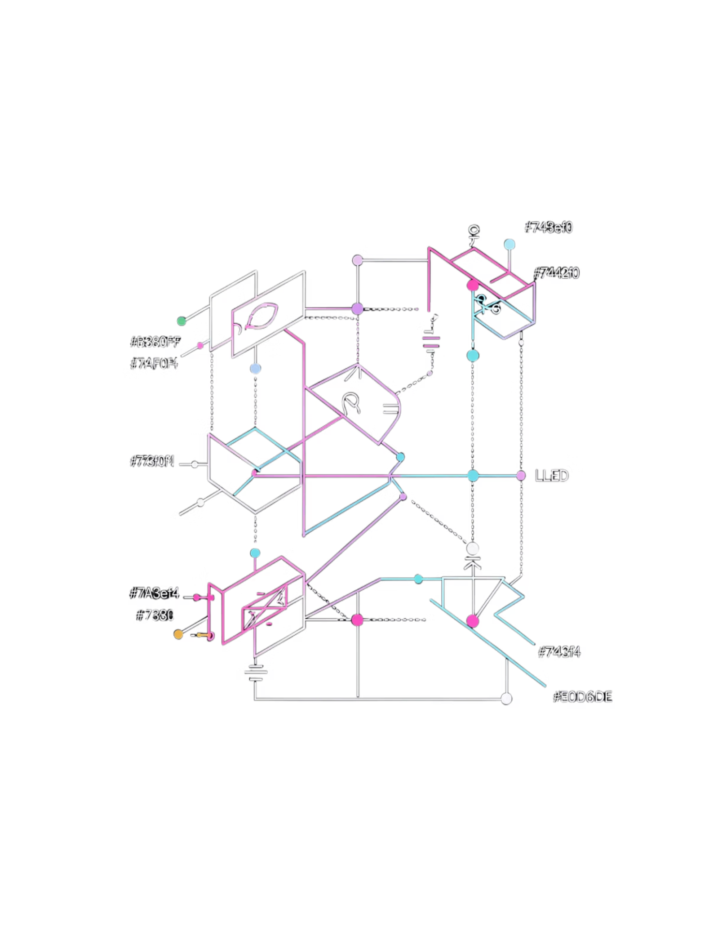



Logisim Circuit Schematic & Implementation
Input Pins & Inverters
Signal processing for L, M, O using NOT gates
Logic Gate Array
2-input AND gates for state detection + OR gate for override prioritization
Output Pins & LEDs
Driving S1 (Full Light) and S0 (Dim Light) with live Poke Tool simulation

Slide 8
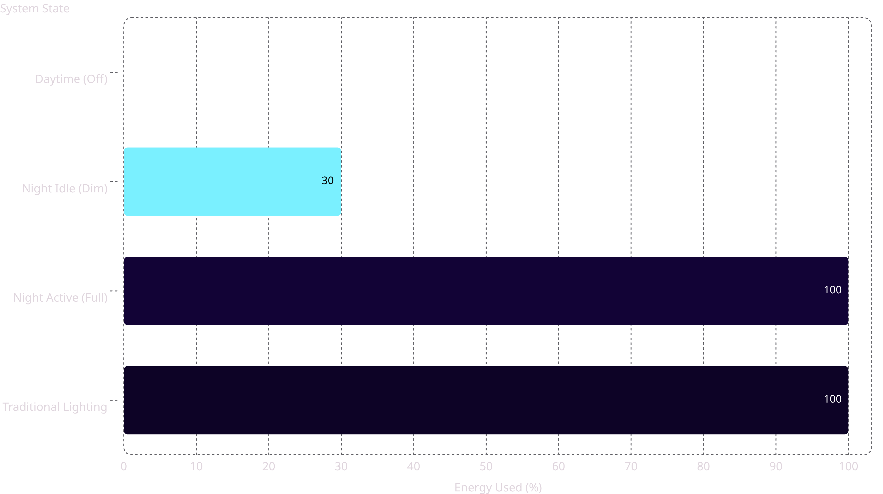
Simulation Results & Performance Metrics
0%
~70%
<10ms
Day Energy
Night Savings
Response Time
Zero consumption during daylight hours
Energy saved vs traditional lighting in idle state
Instantaneous latency on motion detection
Reduces carbon footprint & extends LED fixture lifespan. Automatic maintenance handling — zero manual intervention required.

Slide 9
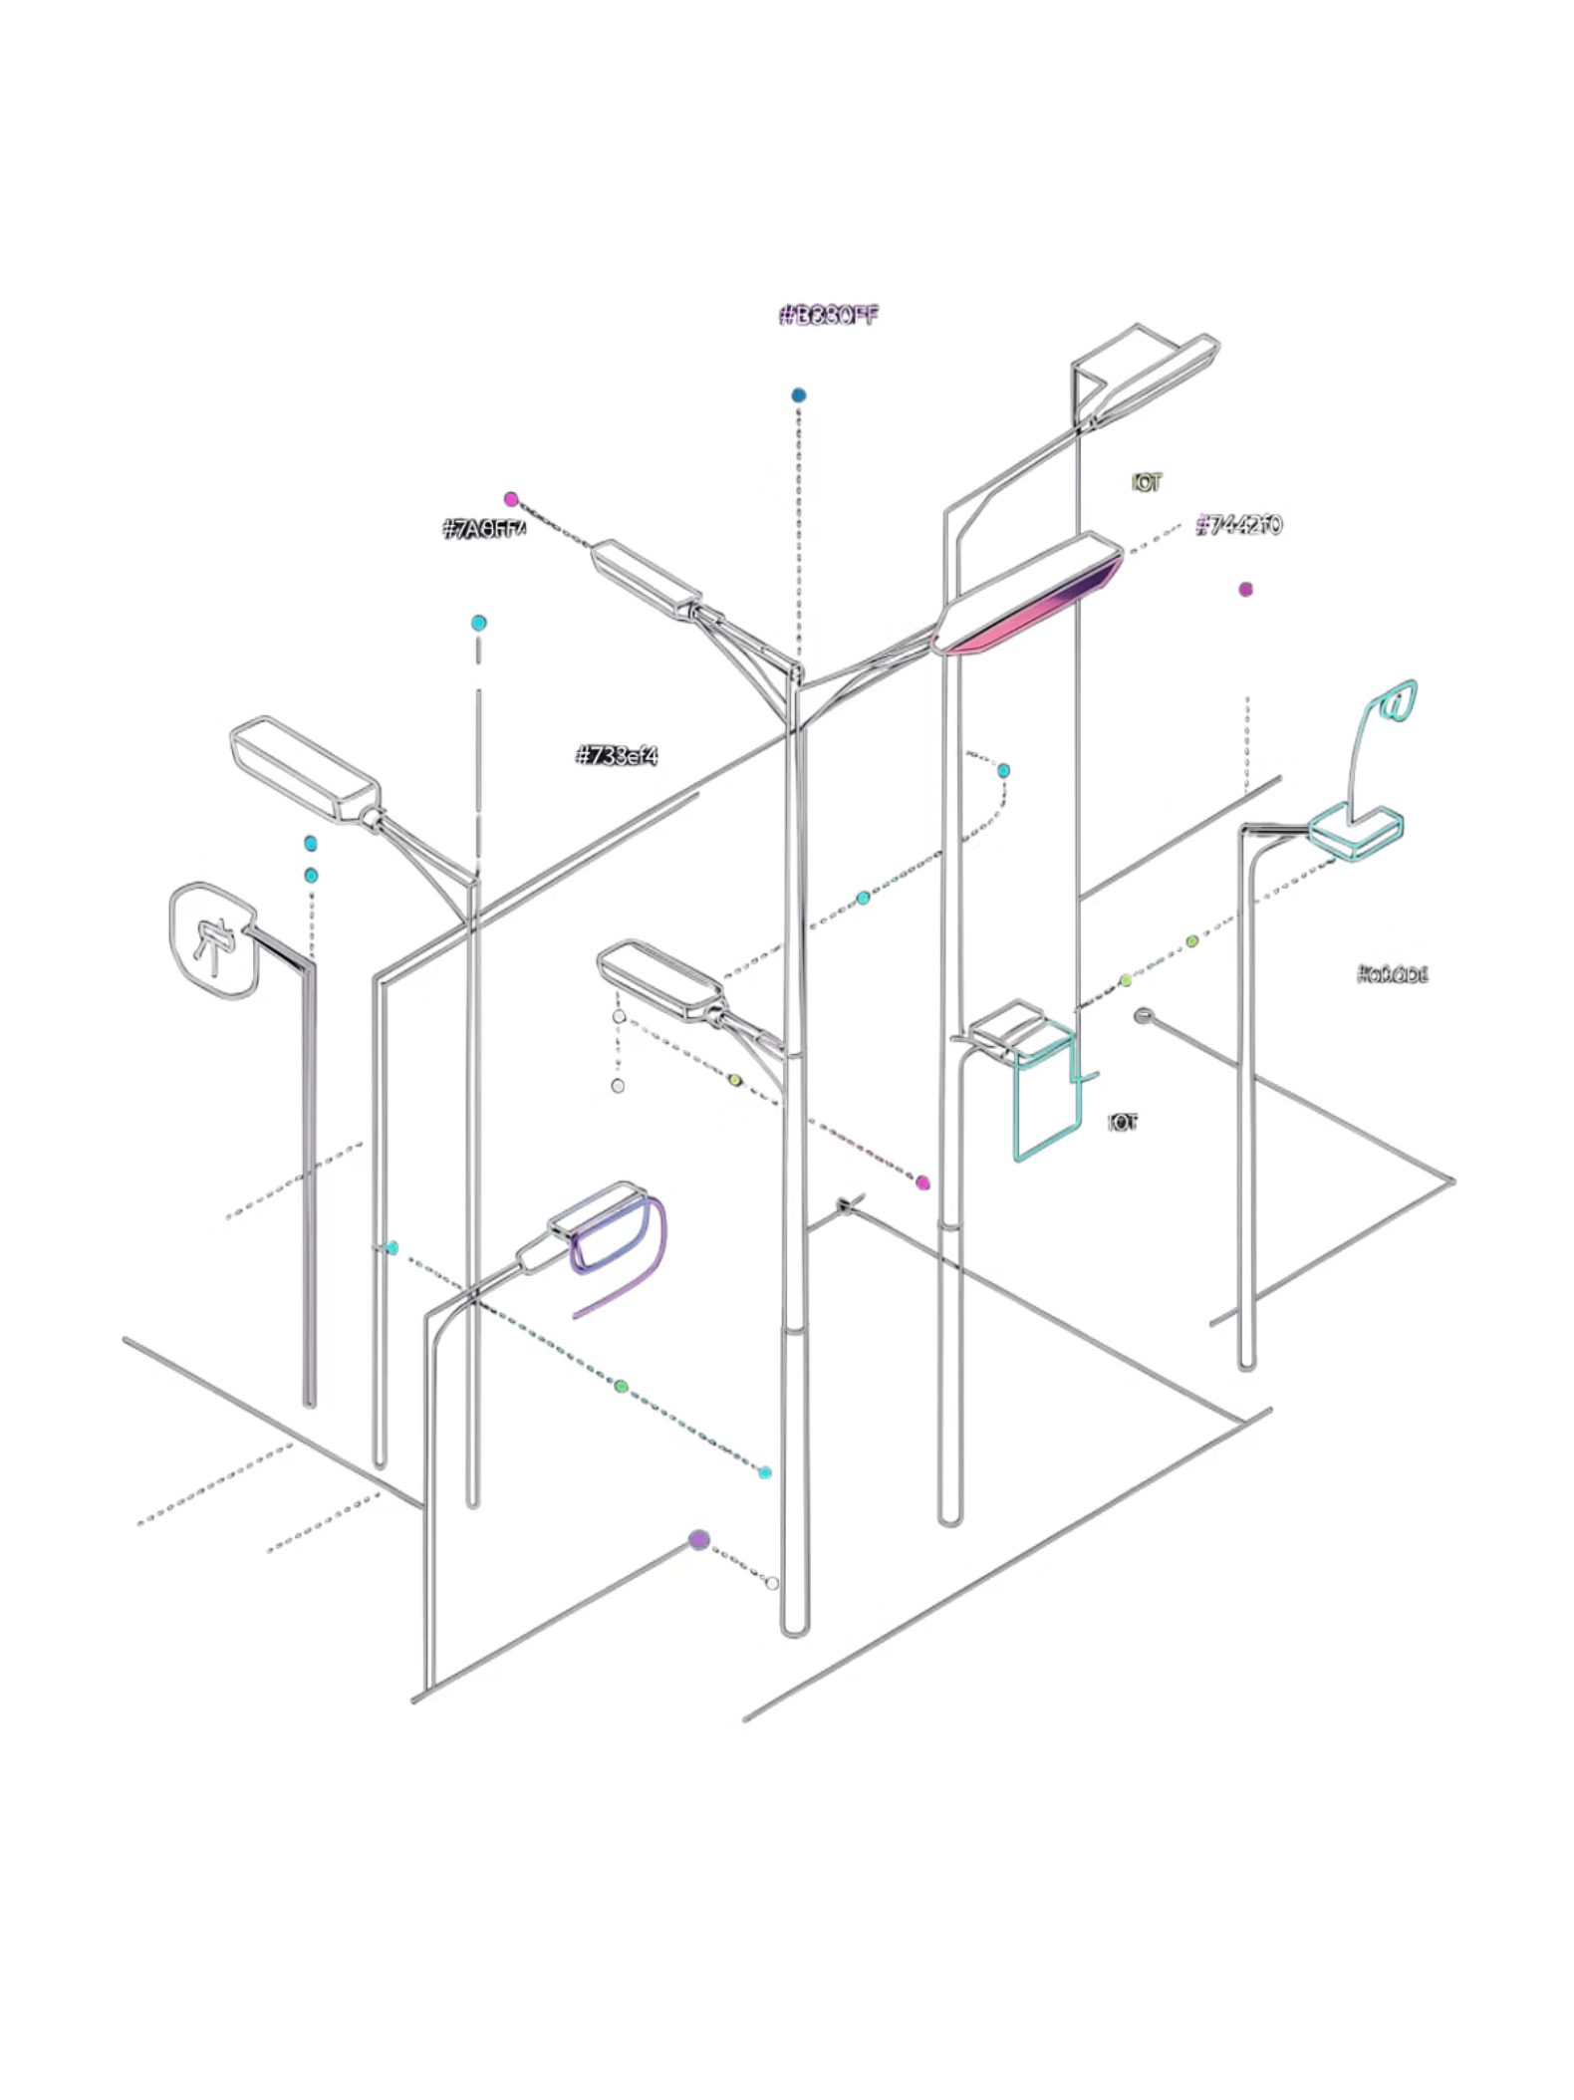
Conclusion & Future Scope
KEY TAKEAWAY
FUTURE ENHANCEMENTS
IoT Integration
Successfully modeled, simulated, and verified in Logisim using core DDCA principles — proving combinational logic can drive real-world energy efficiency.
ESP32 microcontroller for wireless monitoring & remote control
Adaptive Dimming
Ambient weather & fog condition sensing for dynamic brightness
Traffic Analytics
Density-based dynamic brightness adjustment using AI

